Slide 1






Sustainable Agriculture Yield Predictor
Empowering farmers with intelligent, data-driven insights for a greener tomorrow.
Group Members:
Priyanshu Deshmukh
Atharva Dethe
Sharvit Kashikar
Ayushi Nagpure
Dhanashree Giriya
(22070521182)
(22070521156)
(22070521143)
(22070521137)
(22070521147)

Slide 2

Learning Objectives
To explore the potential of machine learning in predicting agricultural outcomes
To understand the relationship between soil, weather, and crop yield
To promote sustainable agriculture through data-backed decision making
To Learn the process of building a predictive model for crop yield.
Explore the use of interactive web apps for data-driven decision making in farming
GOAL
Source :
www.freepik.com/

Slide 3




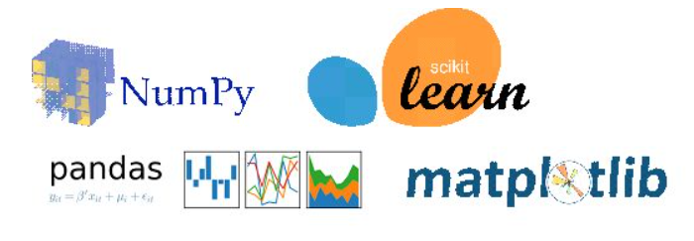
Tools and Technology Used
Development Stack:
Python (Data Analysis + ML)
Streamlit 🌐 (Web-based app for predictions)
VS Code
Libraries Used:
Pandas, NumPy (data preprocessing)
Scikit-learn (machine learning)
Matplotlib (visualization)
ML Models:
Random Forest Regressor

Slide 4
Methodology
Data Acquisition & Preparation
Collected a dataset of ~19,000 records containing Crop, Season, State, Area, Production, Rainfall, Fertilizer, and Pesticide usage
Cleaned the data by removing nulls and extreme outliers in Production and Area
Encoded categorical variables such as Crop, Season, and State
Standardized units to ensure consistency across features
Feature Engineering & Analysis
Selection and analysis of key features influencing crop yield: crop type, state, fertilizer, pesticide, area, rainfall, year and season.
Model Training and Evaluation
Implemented Random Forest Regressor
Used metrics like R² Score and RMSE , Actual vs Predicted plots to evaluate model accuracy
Deployment Via streamlit
Model integrated into a user-friendly Streamlit web app for real-time predictions.

Slide 5
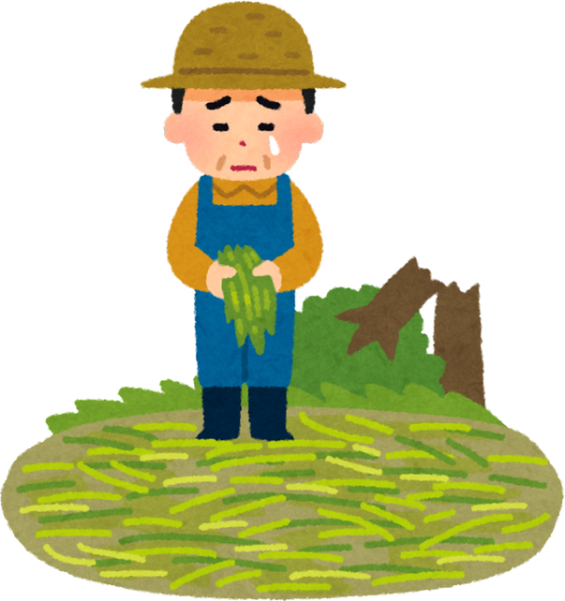
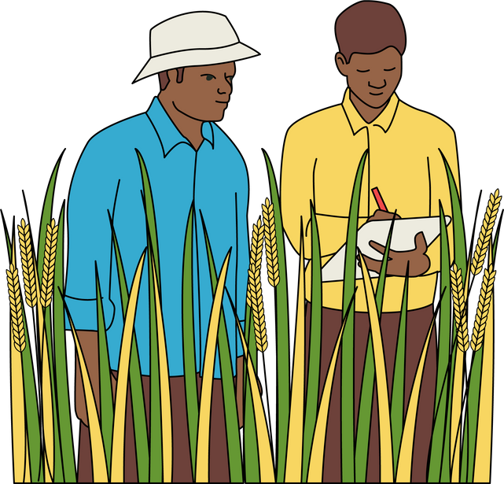
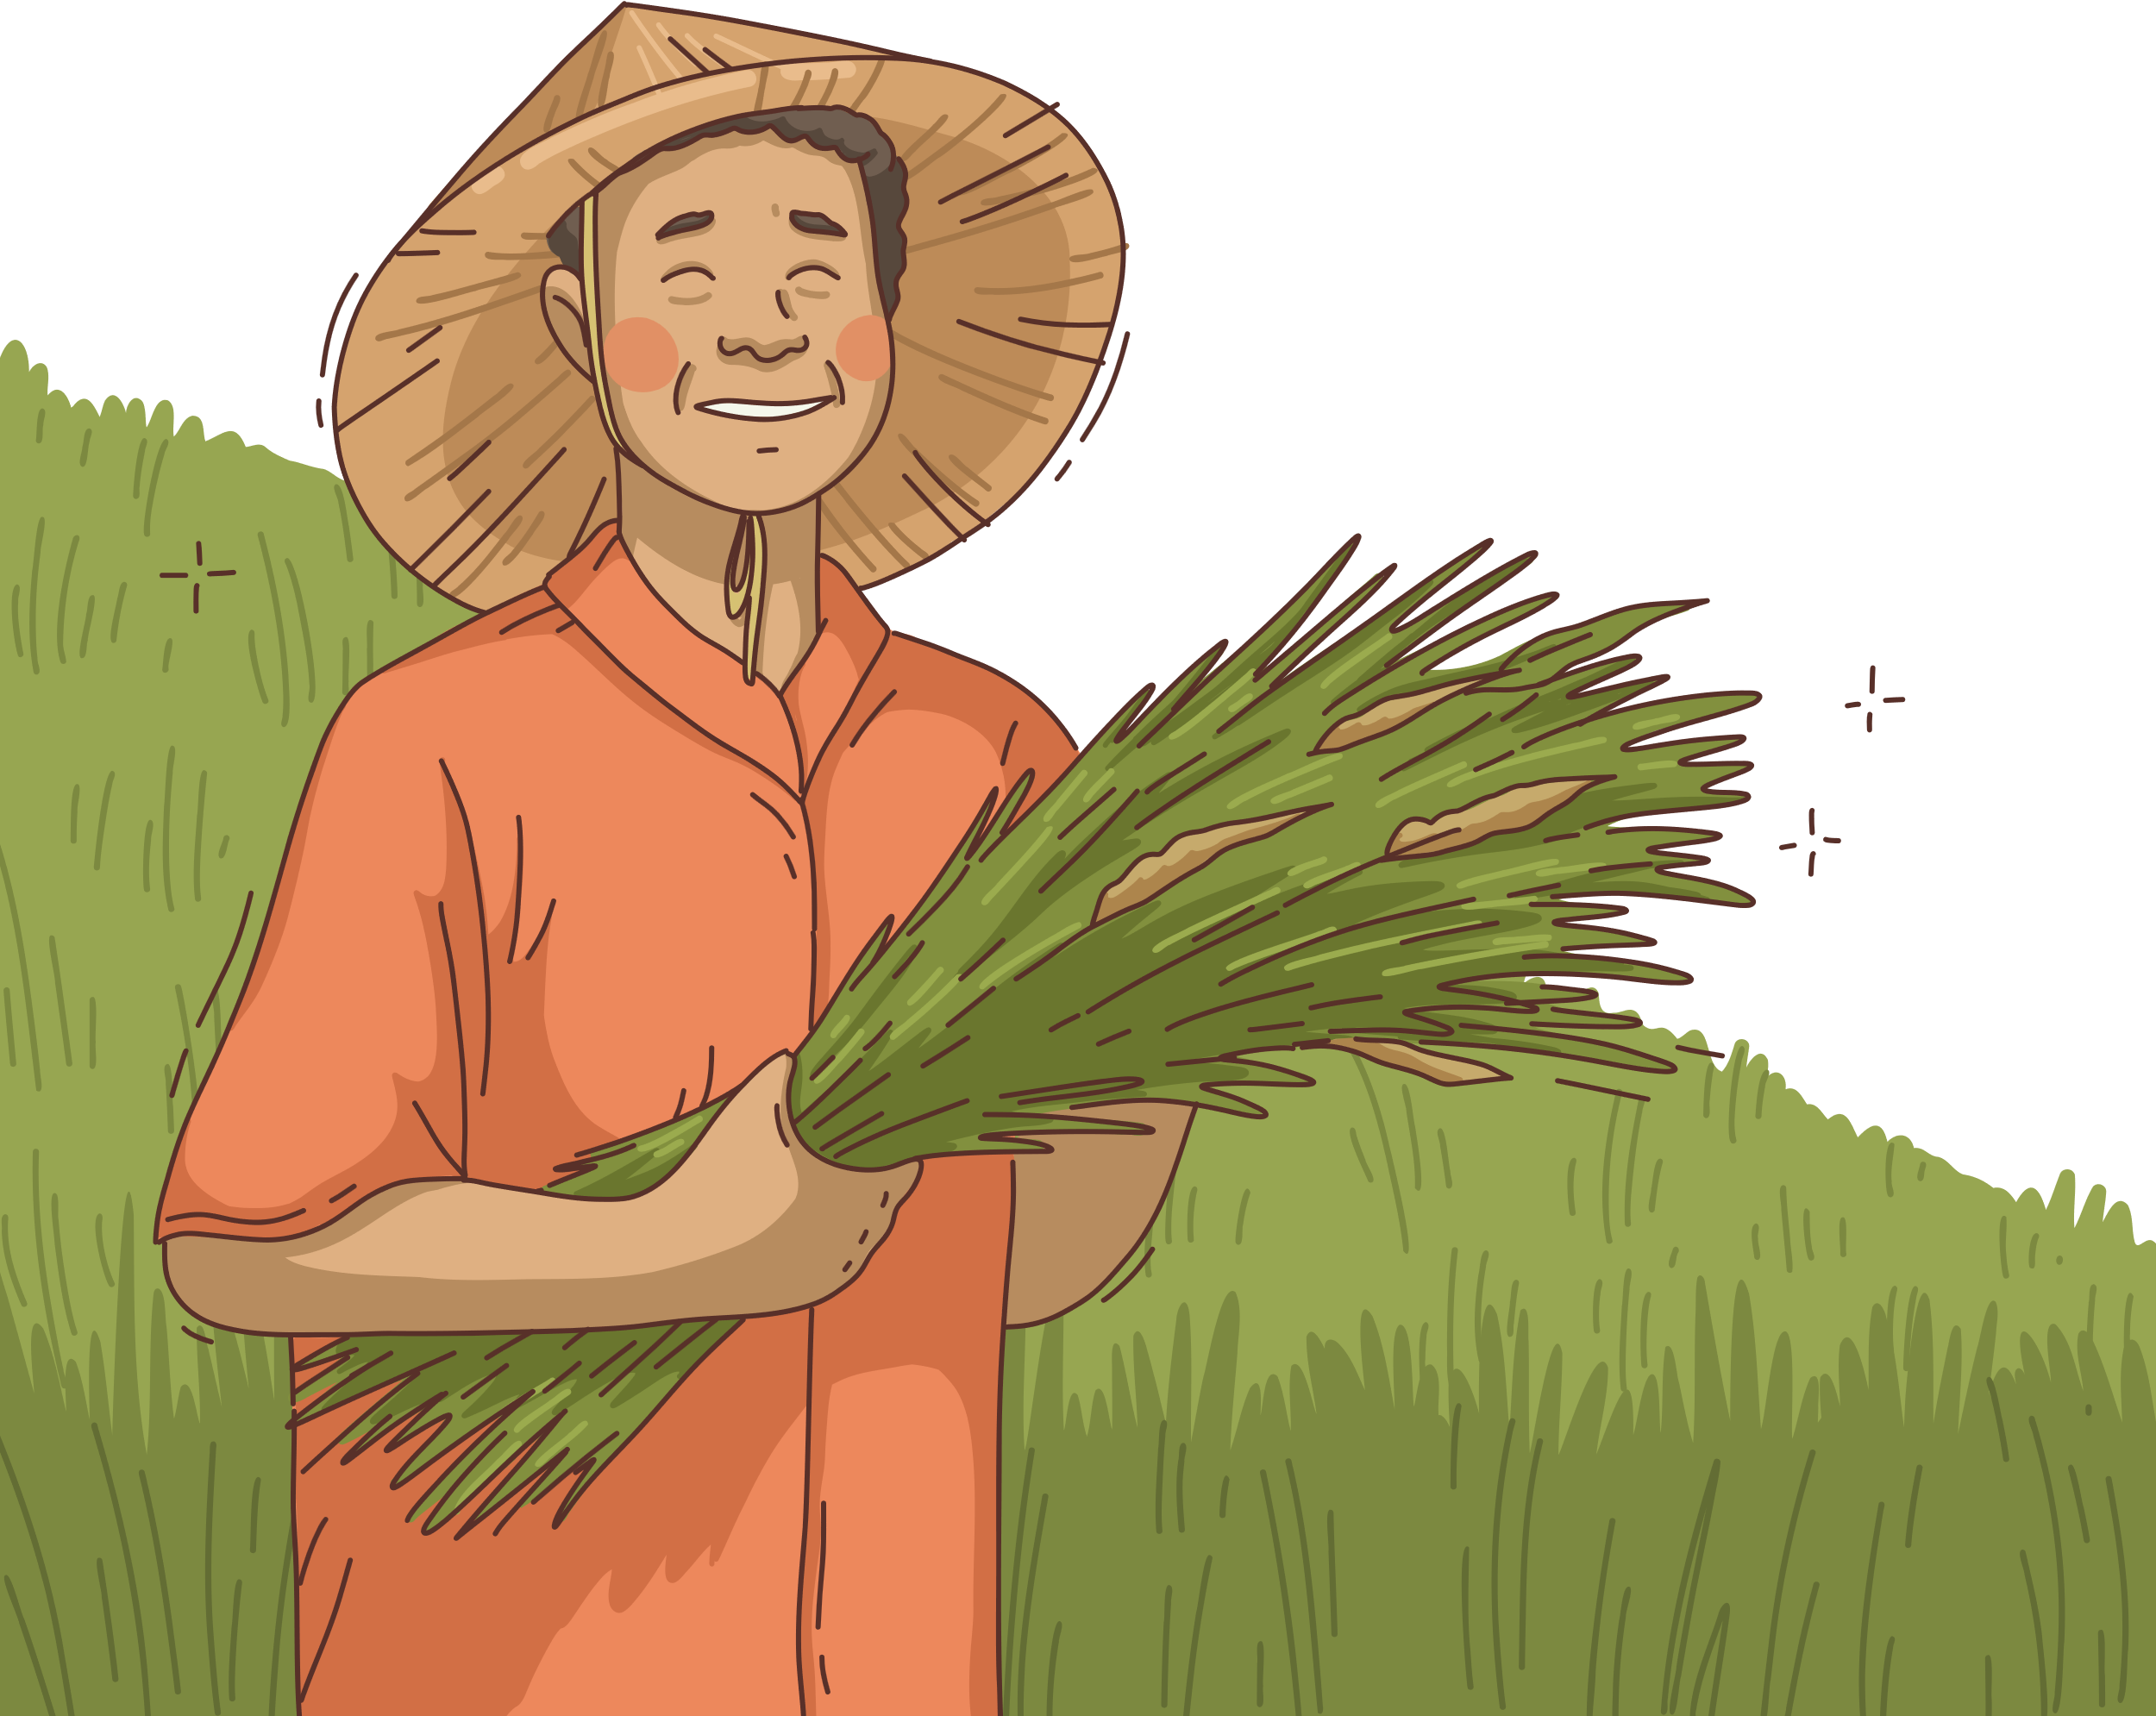
Problem Statement
“Traditional farming relies heavily on guesswork.”
Farmers and stakeholders lack accessible tools to predict crop yields based on changing agricultural inputs and environmental factors.
The sector faces several compounding challenges:
Erratic rainfall due to climate change
Overuse of fertilizers and pesticides, harming soil health
Lack of predictive tools at the grassroots level
Environmental degradation from inefficient resource utilization
These challenges make it increasingly difficult to ensure food security and sustainable agricultural growth.
Our Goal:
To provide an easy-to-use, data-driven tool to forecast crop yields and support sustainable agriculture:
Smart resource allocation
Data-driven decision making
Resilience against climatic uncertainties

Slide 6
Solution
We built a Streamlit-powered machine learning application designed to promote smart, sustainable agriculture through yield prediction.
Aligned UN Sustainable Development Goals (SDGs):
Goal 2 – Zero Hunger: Enhances agricultural productivity and food security
Goal 12 – Responsible Consumption and Production: Encourages optimized input use
Goal 13 – Climate Action: Supports climate-smart farming through data-driven decisions
Goal 15 – Life on Land: Contributes to soil health and reduced land degradation
Future Scope:
Integration with live weather APIs
Expand to more crops and regions
Regional crop recommendations and multilingual support
User Inputs:
Crop, Season, State
Rainfall, Fertilizer, Pesticide
Area of Cultivation
Model Output:
Instant predictions of crop yield (T/Ha).
Visualization of prediction accuracy and feature importance. (Random Forest)
Interface & Accessibility:
Simple, interactive web interface (Streamlit).
Easy-to-use interface for farmers, agronomists, and planners
Accessible across devices with no installation needed

Slide 7
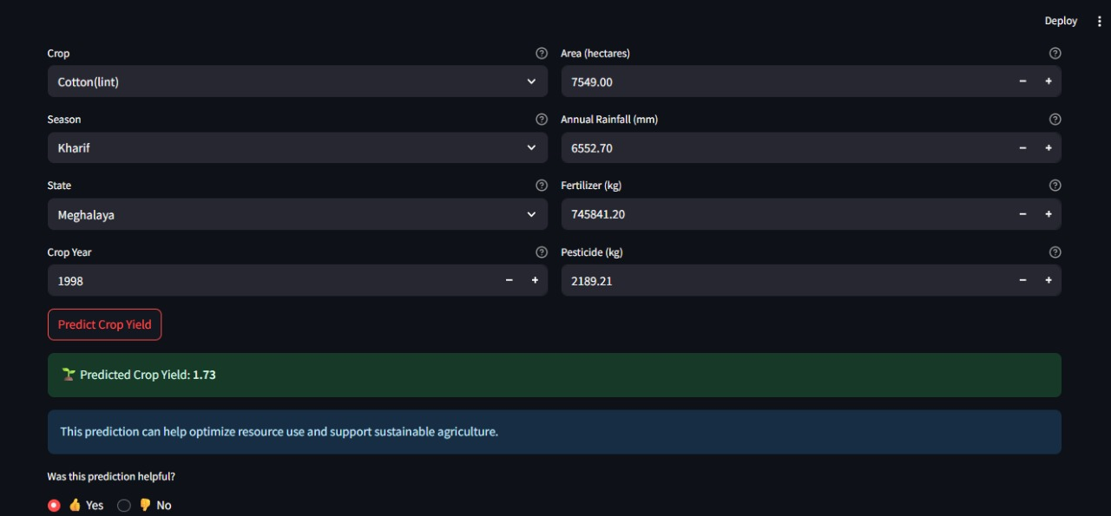
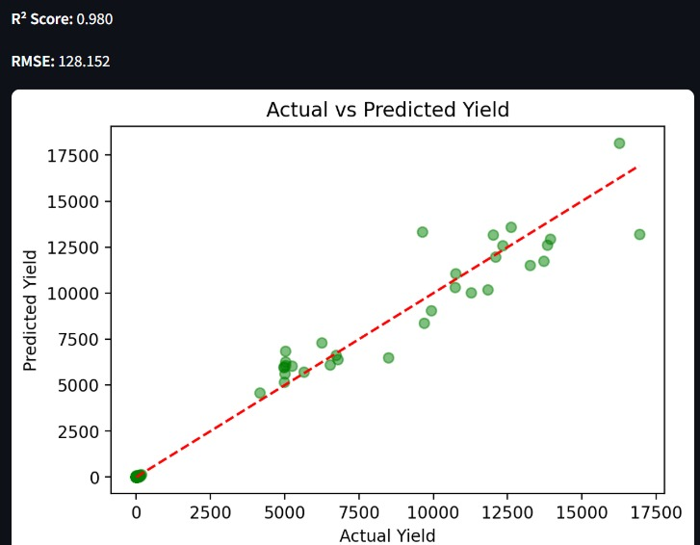
Screenshot of Output
Inputs
Output

Slide 8
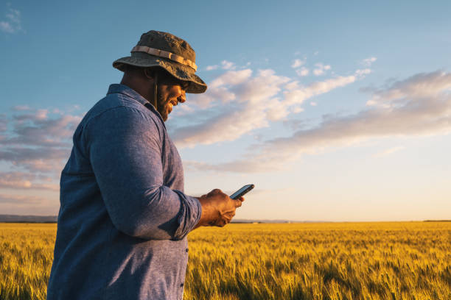
Conclusion
Demonstrates the effective use of machine learning in agriculture.
Provides instant, data-driven crop yield predictions.
Empowers farmers and stakeholders to make informed decisions.
Supports sustainable and optimized resource use.
Offers an accessible and user-friendly web interface.
Lays the groundwork for future advancements in agri-tech solutions.

